Slide 1
Binary Addition

Slide 2
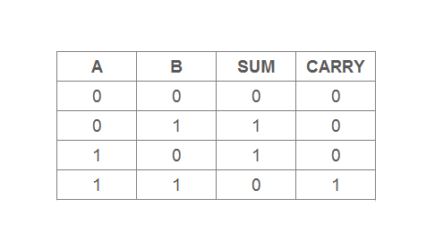

Slide 3
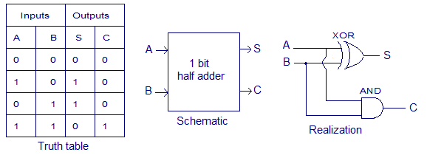
Half Adder

Slide 4
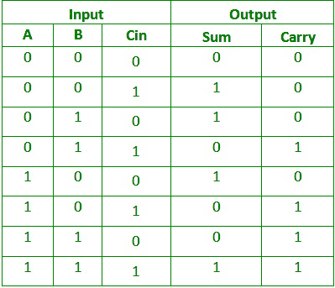
Full Adder Truth Table

Slide 5
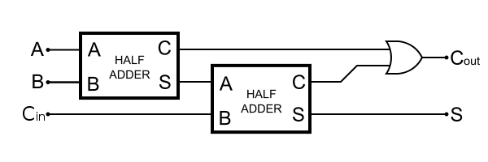
Full Adder

Slide 6
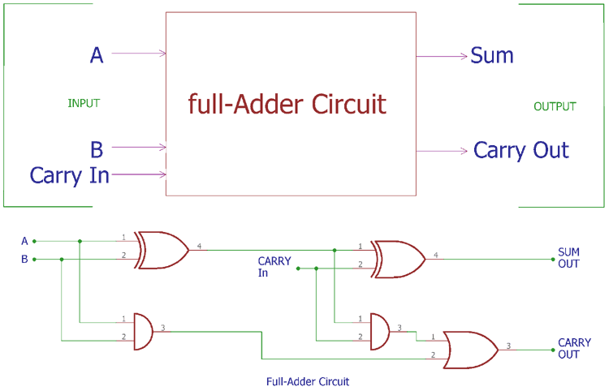
Full Adder Circuit

